Slide 1
Fuel Economy Benefits
FuelEconomy.gov
Photo: iStock 1322102746

Slide 2
Why is Fuel Economy Important?
Saves You Money
You can save over $1,000 each year by choosing the most efficient vehicle that meets your needs.
Reduces Climate Change
Carbon dioxide (CO₂) from burning gasoline and diesel contributes to global climate change.
Fuel economy can benefit everything from the planet to our country to your pocketbook.
Reduces Oil Dependence Costs
Our dependence on foreign oil makes us vulnerable to oil market manipulation and price shocks.
Increases Energy Sustainability
Oil is a non-renewable resource, and we cannot sustain our current rate of use indefinitely. Using it wisely now allows us time to find alternative technologies and fuels that will be more sustainable.

Slide 3
Save Money
A vehicle that gets 30 MPG could cost you $913 less to fuel each year than one that gets 20 MPG.
Over a period of five years, the 30-MPG vehicle could save you $4,565.
Assumes 55% city driving, 15,000 miles of driving annually, and a fuel cost of $3.65
3
Clean Cities and Communities

Slide 4
Reduce Climate Change
Carbon dioxide (CO₂) from burning gasoline and diesel contributes to global climate change.
Highway vehicles release about 1.4 billion tons of greenhouse gases (GHGs) into the atmosphere each year—mostly in the form of carbon dioxide (CO₂).
Roughly half of CO₂ emissions for a typical household come from vehicles.
Photo: iStock 173901713

Slide 5
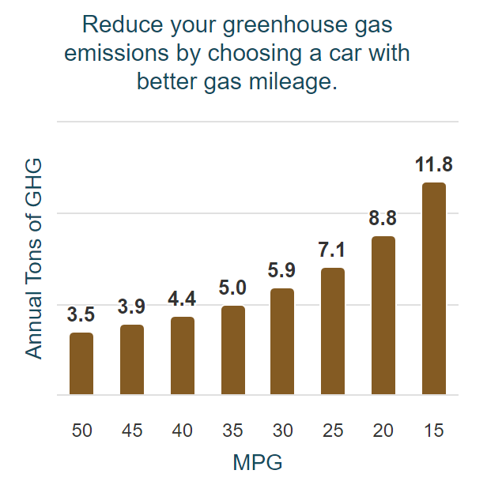
Reduce Climate Change (cont.)
Each gallon of gasoline you burn creates about 20 pounds of GHG.
That's roughly 5 to 9 tons of GHG each year for a typical vehicle.
5
Clean Cities and Communities

Slide 6
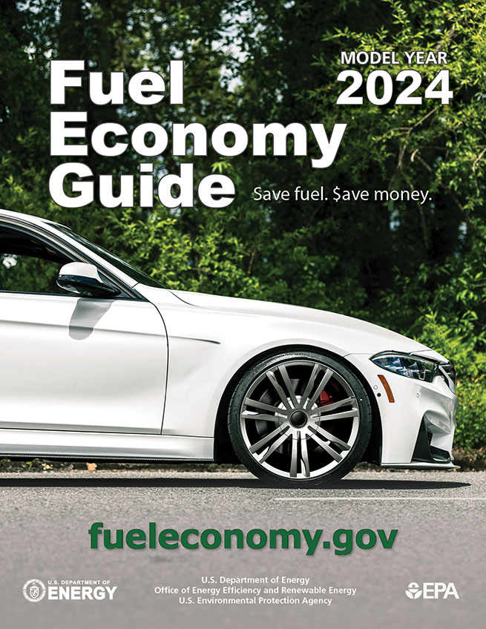
Reduce Climate Change (cont.)
Pollution control devices cannot reduce your car's CO₂ emissions.
You can reduce CO₂ emissions by
Choosing a car with better gas mileage
Improving your fuel economy by following FuelEconomy.gov’s gas mileage tips
Driving less (telecommuting, etc.)
Walking, biking, or taking public transit more often
Combining trips when possible
6
Clean Cities and Communities

Slide 7
Reduce Climate Change (cont.)
You can also reduce CO₂ emissions by driving an alternative fuel vehicle
Electric vehicles emit no CO₂ from the tailpipe. However, the power plant that creates the electricity may emit CO₂.
If you own a plug-in vehicle, purchasing green power can reduce upstream CO₂ emissions at the power plant.
Photo: Oak Ridge National Laboratory (2011-P03692)

Slide 8
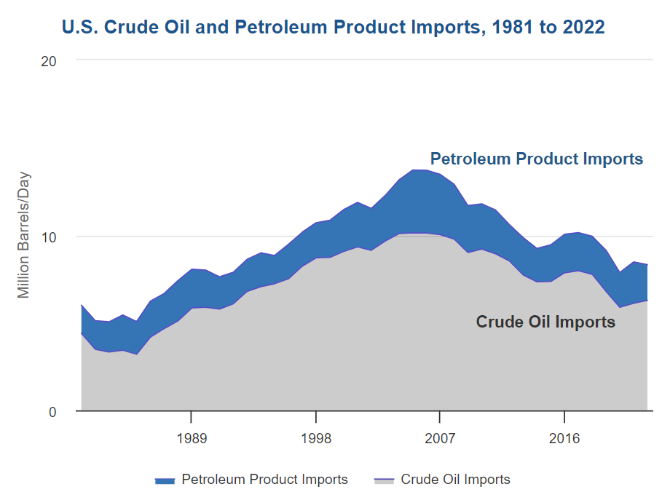
Reduce Foreign Oil Dependence
In 2022, the US imported 2 million barrels of petroleum per day and 6.3 million barrels of crude oil per day.
8
Clean Cities and Communities

Slide 9
Reduce Foreign Oil Dependence (cont.)
The U.S. is less dependent on foreign oil than it was a few years ago.
However, most of the world's oil reserves are still concentrated in the Middle East, and about 71% are controlled by Organization of the Petroleum Exporting Countries (OPEC) members. This gives OPEC considerable influence over the oil market.
Oil price shocks and price manipulation by OPEC have cost our economy dearly in the past—about $2 trillion from 2004 to 2008.
9
Clean Cities and Communities
Photo: iStock 1316669671

Slide 10
Reduce Oil Dependence - Solutions
We can reduce petroleum use by
Developing advanced vehicle technologies that use energy more efficiently
Adopting alternative fuels that can replace petroleum cleanly and cost-effectively

Slide 11
Reduce Oil Dependence - Solutions
You can help reduce oil dependence by selecting a vehicle that uses less petroleum.
FuelEconomy.gov’s energy impact score indicates how much petroleum each vehicle consumes in a year.

Slide 12
Increase Energy Sustainability
Sustainable energy use meets our present energy needs without compromising the ability of future generations to meet theirs.
12
Clean Cities and Communities
Photo: iStock 974187380

Slide 13
Increase Energy Sustainability (cont.)
Sustainable energy requires that energy be
Developed from renewable resources
Produced by cleaner, more-efficient technologies
Used more wisely and efficiently
13
Clean Cities and Communities
Photo: iStock 1046937966

Slide 14
Increase Energy Sustainability (cont.)
Researchers are hard at work exploring new fuels and vehicle technologies.
Hybrid, electric, and fuel cell vehicles are areas of intense research.
Automakers are also using more efficient technologies in conventional gasoline and diesel vehicles.
Renewable fuels such as ethanol and biodiesel can help offset petroleum use.
Photo: iStock 1364354669

Slide 15
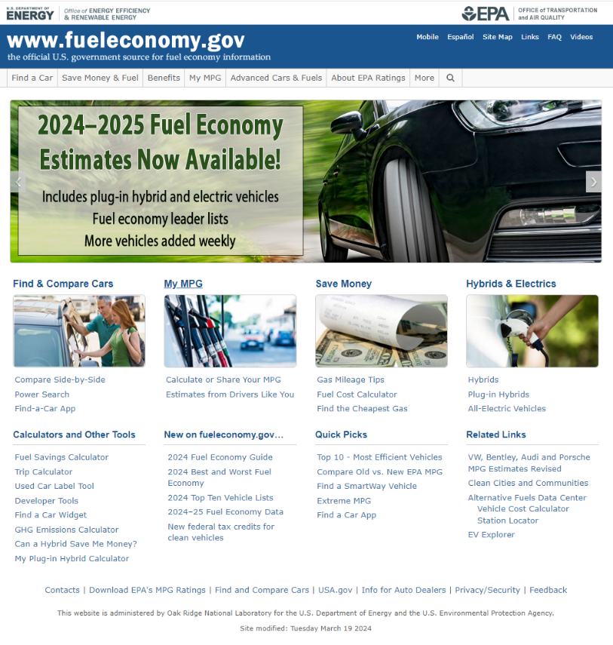
For more information about the benefits of fuel economy, please visit fueleconomy.gov.

Slide 16
Thank you!
Photo: Getty Images 1223485698

